Slide 1
DOCUMENT OBJECT MODEL

Slide 2
Document Object Model
The document object represents the whole html document
When html document is loaded in the browser, it becomes a document object
It is the root element that represents the html document
It has properties and methods
By the help of document object, we can add dynamic content to our web page
As mentioned earlier, it is the object of window. So: window.document or document

Slide 3
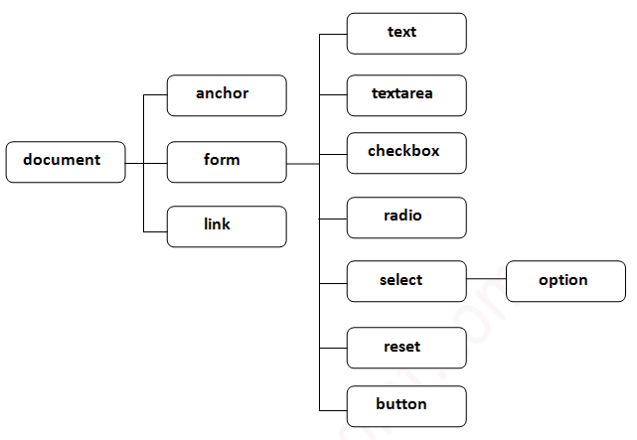
Properties of document object

Slide 4
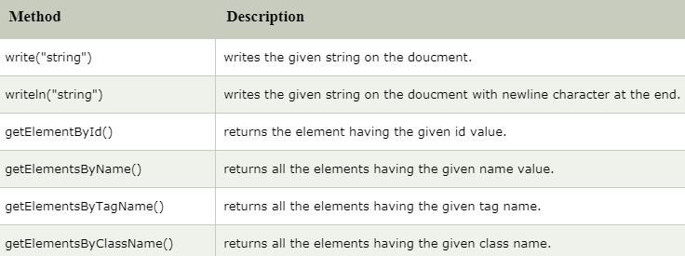
Methods of document object

